Slide 1
Biostatistics III Analysis of Categorical Data
Lecture 15: Interpretation of Model Coefficients and Simple Poisson Regression

Slide 2
Outline
Interpretation and Presentation of MLR model coefficients
Simple Poisson Regression
Your reading
HLS 5.5.
Fleiss, Chapter 12.1 (optional), 12.2 https://onlinelibrary.wiley.com/doi/pdf/10.1002/0471445428.ch12

Slide 3
Interpretation and Presentation of MLR model coefficients

Slide 4
GLOW500 study

Slide 5
GLOW Study Final Model Table
Continuous
Categorical

Slide 6
Part of Table for Odds Ratio
We know that we can compute odds ratios (and 95% CI) for continuous covariates, dichotomous covariates and polychotomous covariates by exponentiating the estimated beta and its 95% CI.
Assume using 0/1 coding for binary, and reference cell method for creating design variables.
Or we can just ask the computation software for it.
Table below shows the estimated OR and 95% for two covariates (the only covariates that are not involved with interaction in this model.
Reference group for raterrisk3

Slide 7
Interpreting OR for raterrisk3
For raterrisk3 (self-reported risk, categorized as either greater than others vs. Less than or same to others), the estimated odds ratio is 1.6.
Widely seen interpretation:
The risk of fracture among women whose self-reported risk is greater than others is 1.6 times larger than a similar women (with respect to the other covariates in the model) who rate their risk as the same or less than others.

Slide 8
Interpreting OR for raterrisk3
Incorrect (but widely seen) interpretation:
The risk of fracture among women whose self-reported risk is greater than others is 1.6 times larger than a similar women (with respect to the other covariates in the model) who rate their risk as the same or less than others.
This is to interpret odds ratio as if it is relative risk.
Which is only OK when the outcome is a “rare” event
Rule of thumb: When outcome occurs less than 10% of time, OR approximate to RR.
Therefore this argument is incorrect since in the GLOW500 data, 25% subject had the event (fracture).
When the event is not rare, the OR overestimates the RR

Slide 9
Interpreting OR for raterrisk3--- The Correct Way
The odds of fracture on follow-up for a woman who perceives her risk as being greater than others is 1.6 times higher than the odds for a similar woman (with respect to the other covariates in the model) whose self-reported risk is less or the same as others.
The increase in the “odds for greater risk than others” could range from no increase (1.0) to as much as 2.56 times higher with 95% confidence.

Slide 10
Interpreting OR for height
We prefer to compute OR for height in unit of 5 (5 centimeters).
OR = 0.79 (95% CI: 0.66-0.95).
Correct interpretation: For every 5 cm increase in height there is a 0.79-fold decrease in the odds of fracture and the decrease could be as much as a 0.66-fold or as little as a 0.95-fold decrease with 95% confidence after controlling for other covariates in the model.
Alternative interpretation (using % change): for every increase of 5 cm in height there is a 21% decrease in the odds of fracture and this decrease could be as much as 34% or as little as 5% with 95% confidence after controlling for other covariates in the model.

Slide 11






Interpreting Odds Ratios for Covariate Involving in the Interaction Term (I)
Interpreting odds ratios for MOMFRAC (mother having had a fracture) and ARMASSIST (arms are needed to stand from a chair).
Since interaction term is involved, the odds ratio should be reported conditioning on the given value of one another.
$$x_{1}$$
$${(x}_{1}=1, x_{2}=0) vs (x_{1}=0, x_{2}=0)$$
$${(x}_{1}=1, x_{2}=1) vs (x_{1}=0, x_{2}=1)$$
$$x_{2}$$
$${(x}_{1}=0, x_{2}=1) vs (x_{1}=0, x_{2}=0)$$
$${(x}_{1}=1, x_{2}=1) vs (x_{1}=1, x_{2}=0)$$

Slide 12
GLOW Study Final Model Table

Slide 13
Interpreting Odds Ratios for Covariate Involving in the Interaction Term (II)
Both mother’s history and needing arms to rise from a chair increase the odds of fracture significantly in the absence of the other factor, with the odds ratio for mother’s history being slightly less than twice that for needing arms to rise (3.5 vs. 1.9)
In the presence of the other factor the odds ratios for mother’s history and needing arms are no longer significant.

Slide 14
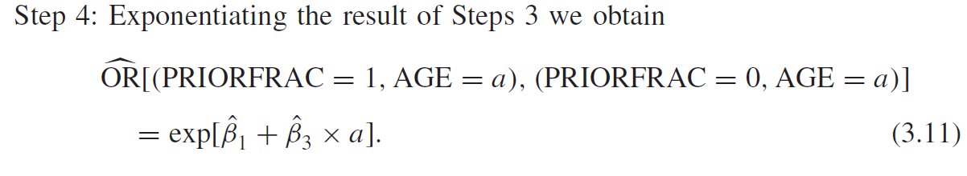
Interpreting Odds Ratios for Covariate Involving in the Interaction Term (III)
We have already assessed the interaction between age (AGE) and history of fracture (PRIORFRAC) in Lecture 9 Slides 39-42.
The interaction is reassessed using the final model, but you could apply the same technique.
The younger the women is, the story of a prior fracture is more important to the odds of a current fracture.
The association of prior fracture becomes not significant after about age 75 (starting where the 95% CI for OR contains 1)

Slide 15
Interpreting Odds Ratios for Covariate Involving in the Interaction Term (IV)
Among women without a history of fracture a 10 year difference in age increases the odds of fracture by almost 1.8 times, while there is effectively no increase among those with a history.

Slide 16
GLOW Study Final Model Table

Slide 17
Burn Injury Study

Slide 18
BURN Study Final Model Table
Both RACE and INH_INJ are binary. For RACE, 0 = NonWhite and 1 = White. For INH_INJ, it is a yes(=1)/no(=0) variable.
Both AGEFP1 and TBSAFP1 are continuous variables, a one term fractional polynomial transformation in the logit. AGEFP1 = (age/10)^2, and TBSAFP1 = sqrt(tbsa).

Slide 19
Interpreting Odds Ratios for Binary Covariates
There is an estimated 46% reduction in the odds of death among whites compared to nonwhites, while involvement of an inhalation injury results in an estimated 4.1-fold increase in the odds of death.

Slide 20
Interpreting Odds Ratios for Transformed Continuous Covariates (I)
If we want to compute the odds ratio for an increase of 10 years of age, it is actually not a constant number anymore, since AGEFP1 = age^2.
The odds ratio changes by the baseline age we want to assess (see computation detail on page 219).
Odds increase significantly for a 10-year increase in age at all ages.
The increase in the odds is less than twofold for subjects younger than 35 years and increase rapidly after age 35, reaching a maximum of about a five-fold increase for subjects in their 80s.

Slide 21
BURN Study Final Model Table
AGEFP1 = (age/10)^2

Slide 22
BURN Study Final Model Table
TBSAFP1 = sqrt(tbsa).

Slide 23
Interpreting Odds Ratios for Transformed Continuous Covariates (II)
If we want to compute estimated odds ratio for a 10% increase in the size of the burn area, it is also not a constant number anymore, since TBSAFP1 = sqrt(tbsa).
The odds ratio changes by the baseline tbsa we want to assess (see computation detail on page 220).
The odds of death increases with an increased burn size, but the multiplicative increase in the odds decreases with size of the burn.
Once a burn reaches a certain size, increasing a bit more does not greatly increase the odds of dying.

Slide 24
Graphic Presentation for Probability of death by Categories and a Continuous Variable
To illustrative the estimated probability of death, we can plot that in terms of a combined category for RACE and INH_INJ, over a change in a continuous variable while fixing the other continuous variable to the median level.
All lines rise rapidly after burn size exceeds 10%.

Slide 25
Graphic Presentation for Probability of death by Categories and a Continuous Variable
To illustrative the estimated probability of death, we can plot that in terms of a combined category for RACE and INH_INJ, over a change in a continuous variable while fixing the other continuous variable to the median level.
Both no inhalation, with white have lower probability than nonwhite.
All lines rise rapidly after age 50.

Slide 26
Simple Poisson Regression

Slide 27
Poisson Distribution
The Poisson distribution is perhaps the second most frequently used discrete distribution after the binomial distribution, named after the French mathematician Siméon Denis Poisson (1791 – 1840).
This distribution is often used to model count data.
Examples:
Distribution of number of death due to lung cancer;
Distribution of number of leukemia;
Distribution of number of ED visits, hospitalizations….

Slide 28
Poisson Distribution (I)
The probability function of Poisson distribution:
where μ is the mean of Y, that is E(Y) = μ.
And also, Var(Y) = μ.
For a Poisson distribution, the minimum value is 0 and the upper limit is +∞.
To denote the above Poisson distribution, Y ~ Poisson(μ).

Slide 29
Poisson Distribution (II)
If we look at the probability of y events in a time period t for a Poisson random variable, we could write:
What does λ represent here?

Slide 30
Poisson Distribution (III)
What does λ represent here?
A rate, the expected number of events in a given population over a given period time.
Often expressed in units such as events per thousand person-years.
The Poisson distribution is the prototype for assigning probabilities of observing any number of events.

Slide 31
Person-year and rate (I)
Just in case you don’t know how to calculate Person-years,
One person-year is a unit of time defined as one person being followed for one year.
Person-years for a sample of n subjects is calculated as the total years followed for the n subjects, where each subject could have different follow-up time.
A real simple example: suppose we have 5 subjects, two of the subjects were followed for 2 years, and two of them are followed for 3 years and the fifth subject was followed for 3.8 years; then
person-years = 2*2 + 2*3 + 3.8 = 13.8 years.

Slide 32
Person-year and rate (II)
Just in case you don’t know how to calculate rate,
Also suppose that we observe one event during the follow-up period, then

Slide 33
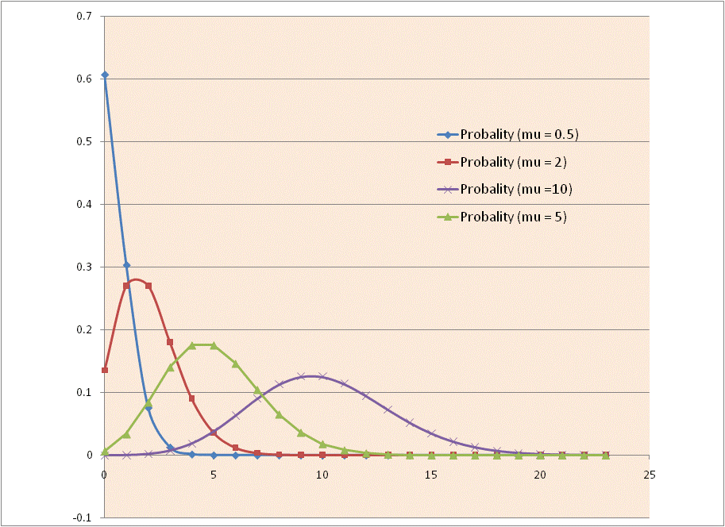
Poisson Distribution
Distribution of Poisson distribution with different mean μ.

Slide 34
Review: Linear Regression and Logistic Regression
Let Y is the dependent variable of interest and x is a predictor variable,
In simple linear regression, we have
In simple logistic regression, we have
Q: What do we model in a Poisson regression?

Slide 35
Simple Poisson Regression Model
Q: What do we model in a Poisson regression?
A: Log of conditional mean of Y given x.
Let Y be a Poisson count for a given unit of time, then μ(x) = λ(x) .
In a simple Poisson regression, we have
So this is also called a “log-linear” model.

Slide 36
Parameter Interpretation (I)
In a simple Poisson regression, we have
How do we interpret β₀ and β₁ ?
In the simple case of x being a binary variable

Slide 37
Parameter Interpretation (II)
How do we interpret β₀ and β₁ ?
By subtraction, we have
What if x is continuous variable?

Slide 38
Parameter Interpretation (III)
How do we interpret β₀ and β₁ ?
What if x is continuous variable?
For each additional unit increase of x, β₁ is the increase in log rate in Y;
Correspondingly, exp(β₁) is the rate ratio associated with one unit increase in x.
In terms of rate, for each additional unit increase of x, there is an exp(β₁) times increase in the rate of Y.

Slide 39
Model Construction – Include Offset (I)
What if we have data that each observation has different period of time?
For example, we look at number of ED visits when subjects are enrolled in Oregon Health Plan, however, each subjects are enrolled in the plan for different length of time…
How do we incorporate this different length of time?

Slide 40
Model Construction – Include Offset (I)
What if we have data that each observation has different period of time?
For example, we look at number of ED visits when subjects are enrolled in Oregon Health Plan, however, each subjects are enrolled in the plan for different length of time…
How do we incorporate this different length of time?
Note we have:
Then

Slide 41
Model Construction – Include Offset (II)
That is, to incorporate the different lengths in the model,
We have one more term in the model and this term is called offset, a known term in the model since t(x) is known from the dataset.

Slide 42
Test for Significance in Parameter (I)
To test the significance of model parameters:
Wald test
under null hypothesis that

Slide 43
Test for Significance in Parameter (II)
To test the significance of model parameters:
Likelihood ratio test (LRT)
and G has a chi-square distribution under null hypothesis
Both tests are best when μ(x) is relatively large.
where df = difference in the number of parameters
between the two models.

